Slide 1
FinMem: A Performance-Enhanced
LLM Trading Agent With Layered Memory and Character Design
Yu et al. IEEE Xplore 2024
Presented by Dan Shoshan & Nimrod Sagi

Slide 2

The Algorithm in the Windowless Room
Imagine a trading algorithm locked in a windowless room.
No news. No Twitter. Just a stream of numbers.
That is how DRL agents trade - they only see price history, not text
They can't read why Tesla dropped 12% - and they can't explain a single Buy or Sell
Real markets are driven by language - earnings calls, analyst reports, tweets, regulatory filings
The question this paper asks: what if we let the algorithm read - and remember?

Slide 3
PART 1 - Background
Why Existing Algorithms Fail
Deep Reinforcement Learning
PPO · DQN · A2C
Plain LLMs (e.g. GPT-4)
frozen weights
Excellent on numerical data
Learns from market rewards
Chokes on rich text - convergence fails
Black box - can't explain a Buy signal
Needs years of history to converge
Great text comprehension
Transparent reasoning chains
Context-window limited - can't feed 5 years
No sense of time decay
Old 10-K looks as fresh as today's news
→ FinMem fills this gap text comprehension + explainability + time decay

Slide 4
PART 1 - Background
FinGPT - Fine-Tuned LLM
What is FinGPT?
An open-source framework (Yang et al., 2023) that fine-tunes Llama-2 on labelled financial sentiment data
Approach: bake financial knowledge into the model weights - the model "knows" finance at training time
FinGPT collects diverse real-time financial data, such as news, social media, and corporate filings.
While FinGPT achieves an impressive 82.1% accuracy in sentiment classification tasks , it performs poorly as an autonomous trading agent, often yielding negative returns and significantly underperforming FinMem.
Strengths: open-source, low cost, domain-adapted language understanding, no need for GPT-4
Weaknesses: frozen knowledge after training - new market events require re-training; smaller model collapses to "Hold" under volatility

Slide 5
PART 1 - Background
Generative Agents - The Smallville Paper
The premise: Park et al. (2023) built a virtual town - "Smallville" and populated it with 25 LLM-powered agents living, working, and socializing together
The discovery: agents only behaved believably when given persistent memory + reflection - without it they forgot context and acted randomly
The characters: each agent has a fixed persona (name, occupation, relationships) injected via prompt - what differs between them is their memory stream content, not the model
The memory mechanism: a flat stream scored by Recency + Importance + Relevance - one shared decay rate for every memory type

Slide 6
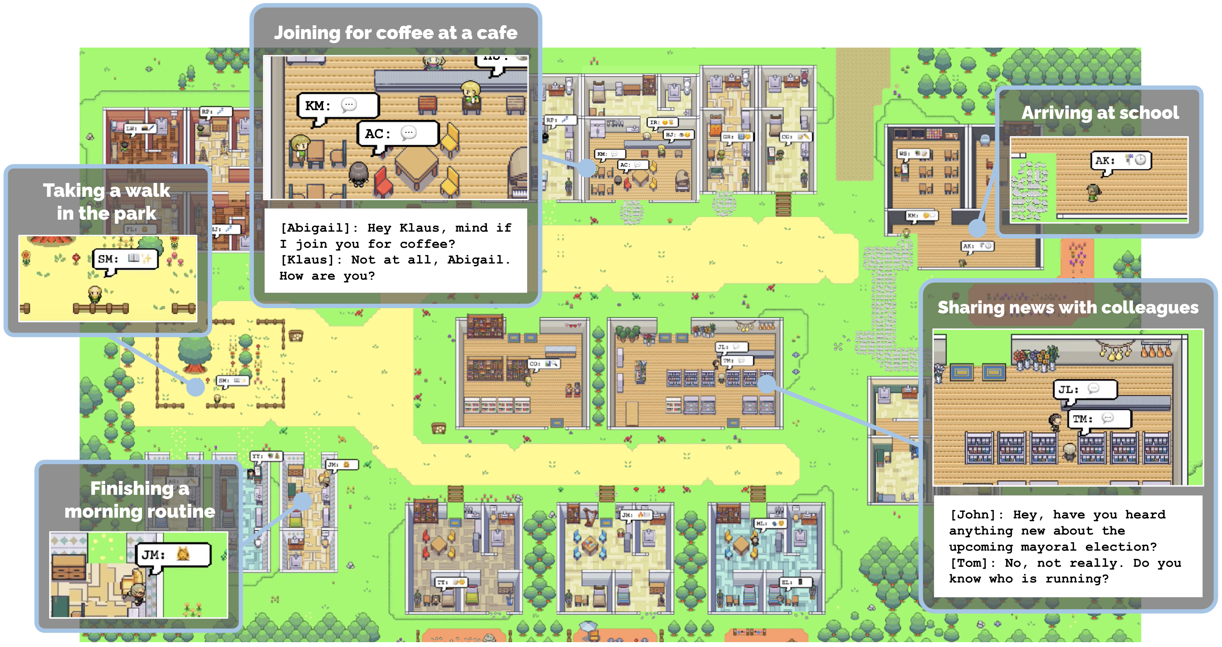
PART 1 - Background
Generative Agents: Interactive Simulacra of Human Behavior
(Park et al. 2023)

Slide 7
PART 1 - Motivation
The Human Bottleneck
Miller's Law
Cognitive Psychology
7±2
items in working memory
An Analyst's Daily Feed
Real-time newsfeed (100s/day)
Quarterly 10-Q filings
Annual 10-K reports (100+ pages)
Social media, sell-side reports
A human cannot weigh a tweet from today against a 10-K from eight months ago.
Miller, G. A. (1956). The magical number seven, plus or minus two: Some limits on our capacity for processing information. Psychological Review, 63(2), 81–97.
We want machines that read, reason, and explain - with human-style memory.

Slide 8
PART 2 - Core Idea
The Intellectual Lineage
Park et al. 2023
Generative Agents - "Smallville"
25 LLM agents in a virtual town
Fixed social personas
Persistent memory stream
FLAT memory - one decay rate for everything
FinMem (Yu et al. 2023)
Finance adaptation of Smallville
Applied to daily stock trading
Dynamic risk profiling
Memory promotion
LAYERED - decay rate changes per layer
→
adapts

Slide 9
PART 1 - Background
Task Definition & Baselines
The Task
Daily Buy / Sell / Hold on a single stock
5 tickers: TSLA NFLX AMZN MSFT COIN
Data Inputs
Alpaca News API (daily text)
SEC EDGAR (10-Q, 10-K filings)
yfinance (adj. closing prices)
COIN = recent IPO → DRL can't train.
LLM-based agents can start day one.
Baselines
Buy & Hold (passive floor)
PPO · A2C · DQN (DRL gold standard)
Generative Agents (Park et al. 2023)
FinGPT (Yang et al. — financial LLM)

Slide 10
PART 2 - Core Idea
Architecture Overview
Profiling Module
Character & Risk Persona
Risk-Seeking
Risk-Averse
Self-Adaptive (dynamic)
Prompt-engineered persona
Memory Module
Layered Storage + Working Memory
Shallow (daily news)
Intermediate (10-Q)
Deep (10-K + reflections)
Working memory (scratchpad)
Decision-Making Module
Retrieve → Reason → Act
Top-K retrieved per layer
Structured LLM prompt
Reasoning chain → Buy/Sell/Hold
Logs every decision

Slide 11
PART 2 - Methodology
The Profiling Module
Risk-Seeking
Trades aggressively
Frequent Buy signals
Rides upward momentum
Active position changes
→ Triggered when short-term return > 0
Risk-Averse
Trades conservatively
Defaults to HOLD often
Cuts losses early
Reduces position sizes
→ Triggered when short-term return < 0
Self-Adaptive ★
Dynamic - the key innovation
Monitors short-term cumulative return
Switches persona based on performance
Rewrites its own system prompt mid-game
Switching rule: if short-term return < 0 → Risk-Averse | if > 0 → Risk-Seeking | The Framework injects the appropriate risk persona into the prompt mid-game

Slide 12
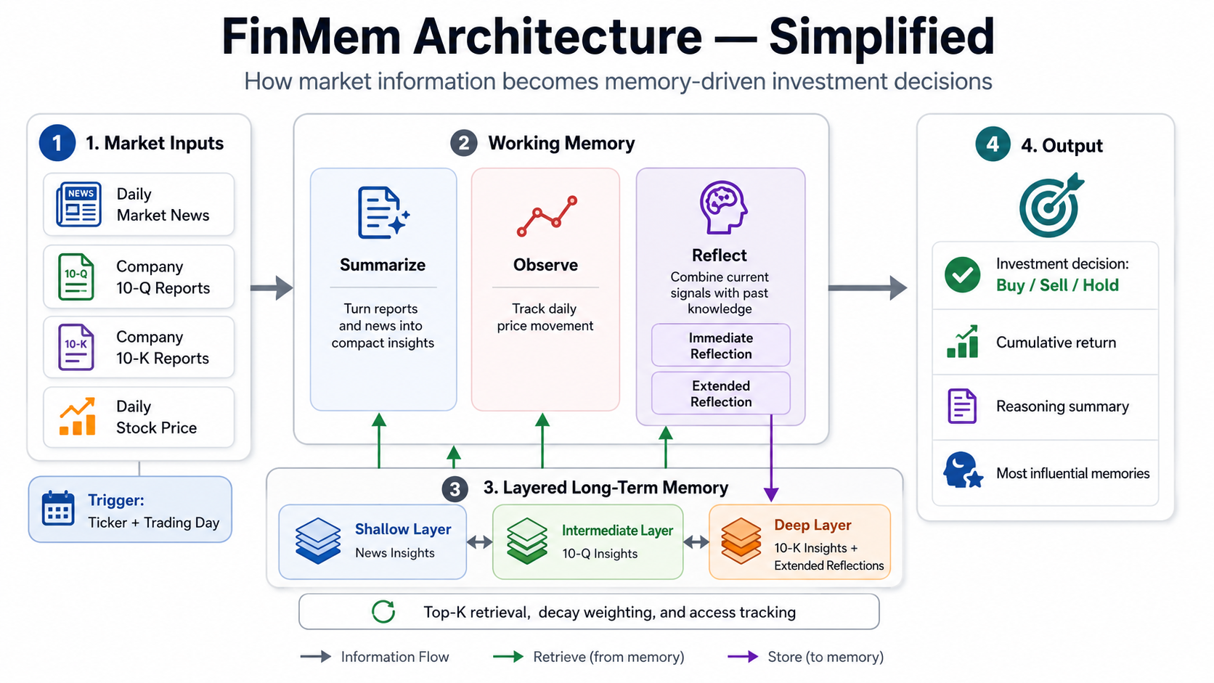
Flow

Slide 13
PART 2 - Methodology
The Data Pipeline
1
Fetch & summary
Sources
Alpaca News API - Daily text headlines
SEC EDGAR
10-Q / 10-K filings
yfinance
Summary by LLM
2
Sentiment
FinBERT
Transformer fine-tuned on financial text
Outputs [POS/NEU/NEG]
Label appended to text
3
Embed
Vectorize
OpenAI ada-002
Convert text → vector
Semantic similarity
Enables FAISS lookup
4
Store
FAISS
Vector database
Separate index per layer
Efficient top-K retrieval
Different params per layer
→
→
→

Slide 14
Flow

Slide 15
PART 2 - Methodology
The Layered Memory Module
Layer
Source Data
Decay Rate
Cognitive Analog
Shallow
Daily news
Fast (14 days)
Short-term memory
Intermediate
Quarterly 10-Q
Moderate (90 days)
Episodic memory
Deep
Annual 10-K + reflections
Slow (1 year)
Semantic/procedural
Working
LLM's active scratchpad
Transient
Conscious thought

Slide 16
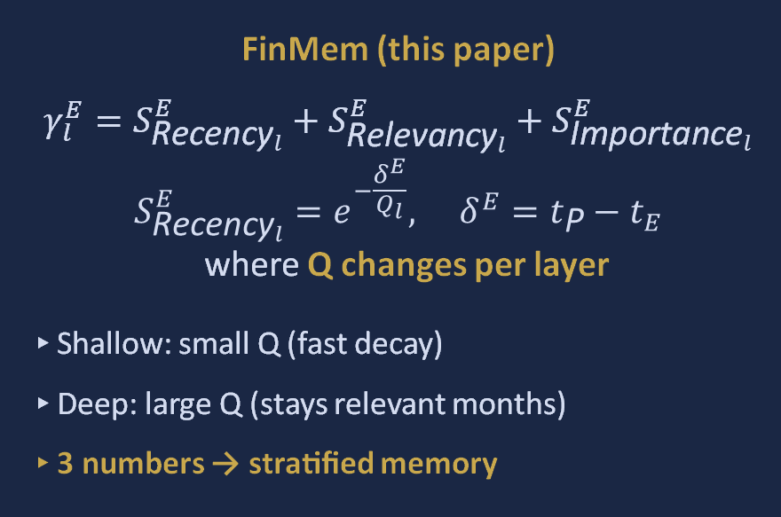
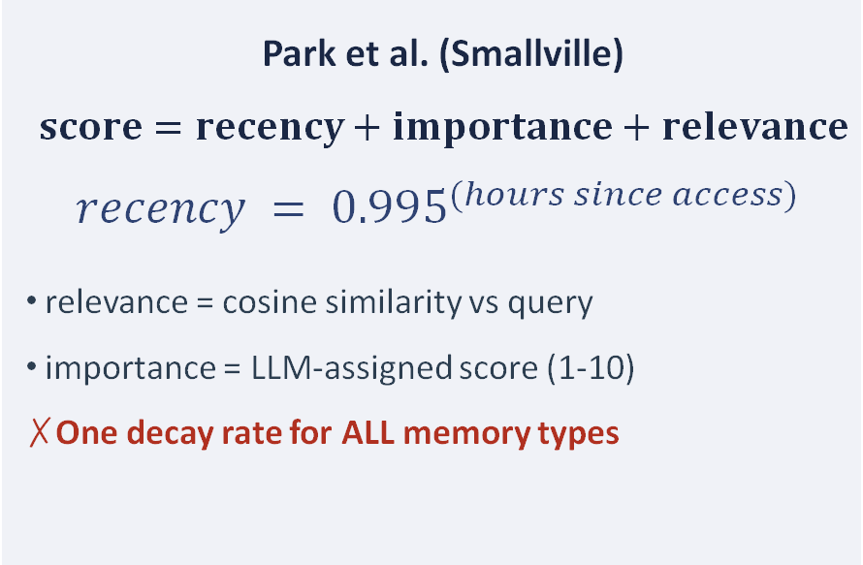
PART 2 - Methodology
The Memory Scoring Formula
Park et al. (Smallville)
$$score=recency+importance+relevance$$
$$recency = {0.995}^{(hours since access) }$$
relevance = cosine similarity vs query
importance = LLM-assigned score (1-10)
One decay rate for ALL memory types
FinMem (this paper)
$γ_{l}^{E}=S_{{\text{Recency}}_{l}}^{E}+S_{{\text{Relevancy}}_{l}}^{E}+S_{{\text{Importance}}_{l}}^{E}$
$$S_{{\text{Recency}}_{l}}^{E}=e^{−\frac{δ^{E}}{Q_{l}}}, δ^{E}=t_{\text{P}}−t_{E}$$ where Q changes per layer
Shallow: small Q (fast decay)
Deep: large Q (stays relevant months)
3 numbers → stratified memory
Same formula: the novelty is Q changing per layer
*Sensitivity analysis justifies 14 days as optimal for the Shallow layer. However, the Q values for Intermediate (90 days) and Deep (365 days) remain untested heuristics.

Slide 17
PART 2 - Methodology
Access Counter: Memory Promotion
1
Headline retrieved
Memory retrieved from Shallow layer, used in today's decision
2
Trade profitable
Access counter increments: access_counter += 1
3
Threshold crossed
+5 bonus to importance score
4
Promoted to Deep
Decay clock reset. Short-term noise graduates to long-term signal
→
→
→
Source: brain.py (authors' GitHub)
cur_record["access_counter"] += cur_feedback
Novel vs Park: Profit-validated memories earn their way into long-term storage. Short-term noise can graduate to long-term signal.

Slide 18
Flow

Slide 19
PART 2 - Methodology
The Reflection Process
Two types of reflection
Immediate Reflection: happens upon receiving a daily trading inquiry to generate the trading decision itself - the agent merges market indications with retrieved memories, outputs the trading direction, logs the reasoning, and records the influential memory IDs.
Extended Reflection: reevaluates immediate reflection outcomes over a look-back window of M trading days - the agent reviews the past M days, synthesizes patterns, and promotes key insights into long-term (Deep) memory.
The M hyperparameter
M controls the size of the look-back window - it adjusts the working memory capacity and information retrieval ability.
The system uses M = 7 days (as defined by look_back_window_size in the config files)
*No sensitivity analysis is provided for this parameter.

Slide 20
Flow

Slide 21
PART 2 - Methodology
Decision-Making & Top-K Cognitive Span
1
Retrieve Top-K=5
2
Build Prompt
3
GPT-4 Turbo
4
Reasoning Chain
5
Buy/Sell/ Hold
→
→
→
→
Example reasoning chain (from paper):
"Tesla's recent earnings beat expectations, but the broader EV sector shows weakness due to supply chain concerns.
Given my self-adaptive profile and the negative short-term trend, I recommend HOLD."
Guardrails AI Integration: Enforces strict output schema validation (Buy/Sell/Hold & valid memory IDs) with automated re-asking to prevent code execution failures.
Explainability win: compliance officers can audit the reasoning chain.

Slide 22
PART 3 - Results
Headline Results: Sharpe Ratios
Stock
Buy & Hold
DQN
PPO
A2C
FinGPT
FinMem ★
Observations:
AMZN: only FinMem positive in a brutal bear market (+0.23)
COIN: DRL columns empty - needs years of history. LLMs don't.
TSLA 2.67 = Should trigger suspicion.
TSLA
-0.49
-0.41
0.18
-0.06
-0.27
2.67
NFLX
0.12
-0.48
0.31
0.04
0.10
2.01
AMZN
-0.49
-0.62
-0.21
-0.38
-0.51
0.23
MSFT
0.78
0.05
0.41
0.22
0.55
1.84
COIN
-0.31
—
—
—
-0.12
1.62

Slide 23
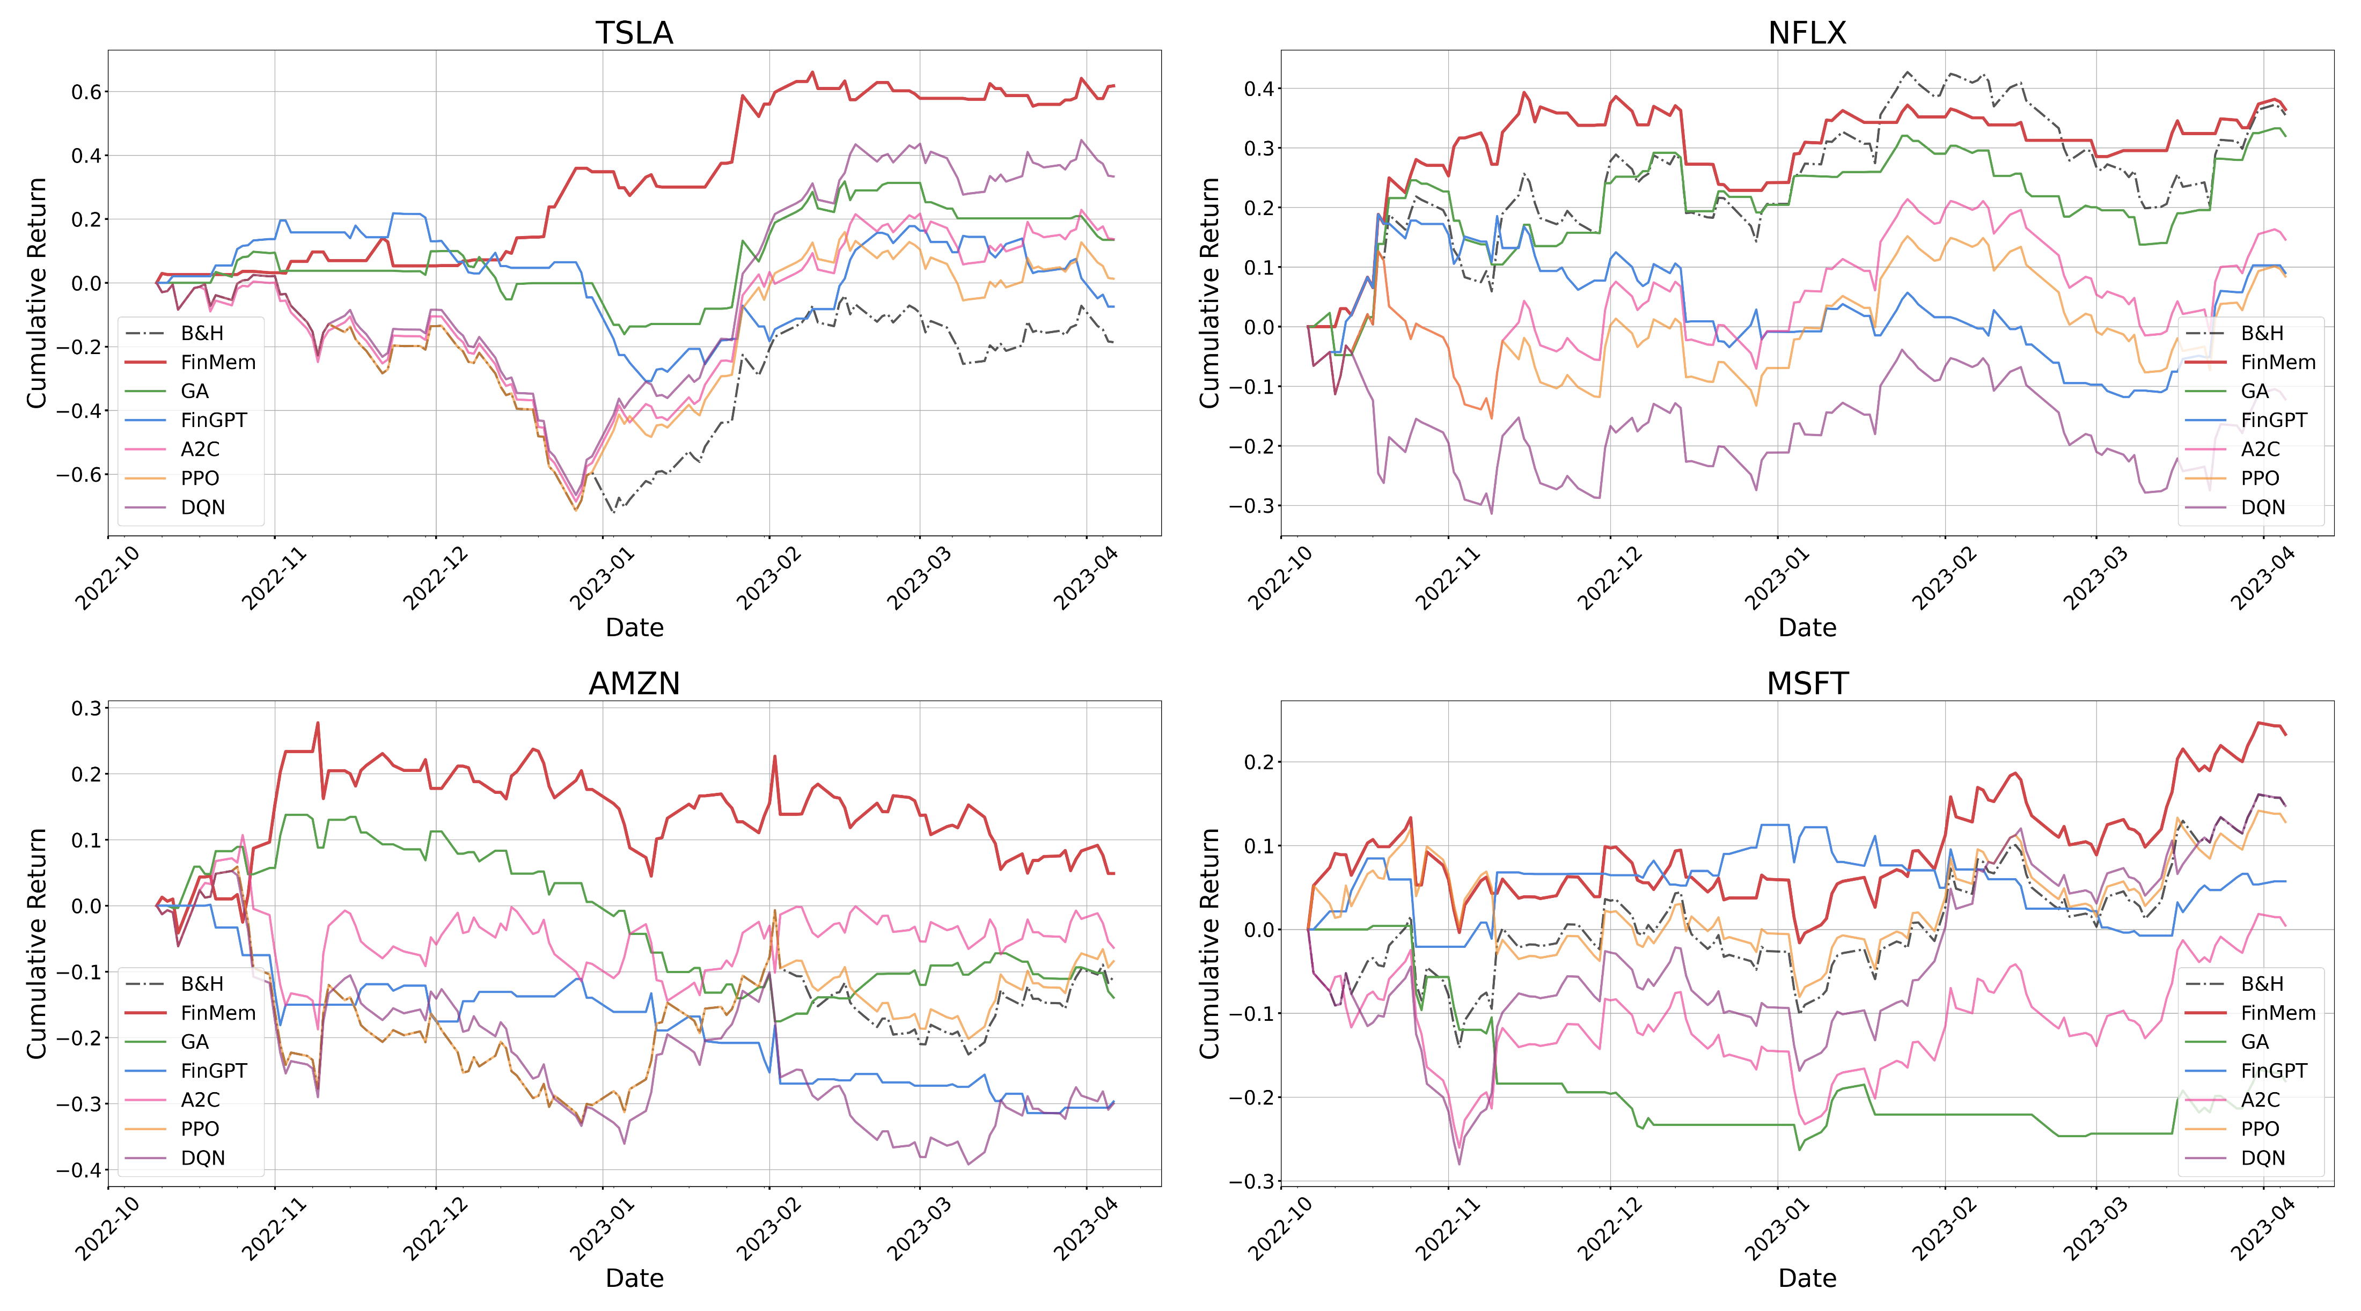

Slide 24
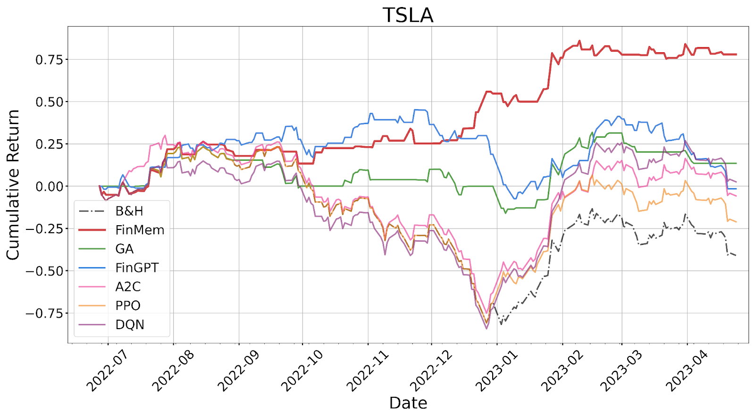
PART 3 - Results
The TSLA Case Study: Regime-Switching
Phase 1: Jun-Oct 2022
Tesla relatively stable
Agent profile: Risk-Seeking
Frequent Buy signals
Riding upward momentum
Active position changes
Phase 2: Oct 2022 Tesla sustained downturn
Agent profile: Risk-Averse (auto-switched)
Far more HOLD actions
Cumulative return flatlines (doesn't crash)
Agent switched autonomously

Slide 25
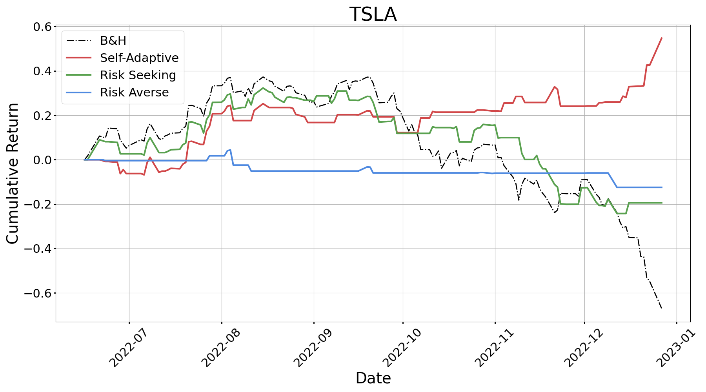

Slide 26
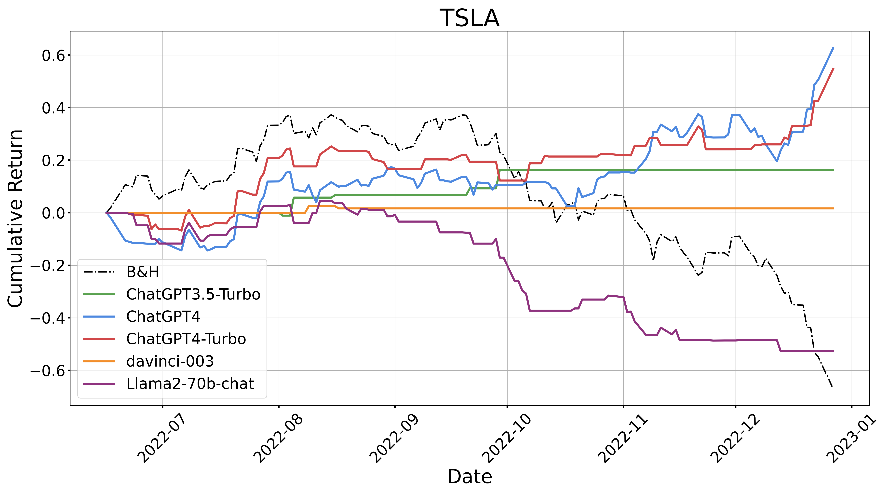
PART 3 - Results: Ablation
Ablation: Which LLM Backbone?
2.49
2.22
Sharpe Ratio
2.15
0.85
-2.85
GPT-4 Turbo
GPT-4
GPT-3.5 Turbo
Davinci 003
Llama-2 70b

Slide 27
PART 3 - Results: Ablation
Ablation: Top-K Cognitive Span
★ Peak performance
Overload - false confidence and more volatility
Miller's Law: 7±2
Optimal K for LLM agent is double
the human cognitive constant.
Improving
Underfitting - tunnel vision
K=1
K=3
K=5
K=10
K=5 optimal: Memory-augmented LLMs may have analogous cognitive bottlenecks to humans.

Slide 28
PART 3 - Results: Head to Head
FinMem vs FinGPT
FinGPT (Yang et al. 2023)
FinMem (Yu et al. 2023)
Fine-tune the model
Scaffold around the model
VS
Backbone: Open-source Llama (7 B-13 B)
Backbone: GPT-4-Turbo (proprietary, frozen)
Training: ~$300 fine-tune on financial corpus
Training: Zero - no gradient updates ever
Knowledge: Baked in at training time - frozen after
Knowledge: Retrieved live via RAG + vector DB
Updates: Retrain = full fine-tune cycle (~days/weeks)
Updates: Swap the vector DB - minutes, not weeks
Explainability: Limited - no reasoning chain output
Explainability: Full reasoning chain per decision
Cost/day: Negligible inference (small open model)
Cost/day: ~$0.10–0.20 per stock (GPT-4 API)
Sharpe (TSLA): −0.27 (worse than Buy & Hold)
Sharpe (TSLA): 2.67 (Note: suspiciously high)
FinGPT encodes financial knowledge into weights - expensive to update, fast to run. FinMem keeps the model generic and externalises knowledge into a memory store - free to update, but dependent on API pricing.
Some of FinMem's lead over FinGPT may be the architecture - but some is just GPT-4-Turbo's model size.

Slide 29
PART 4 - Critical Assessment
Sanity Check: Is a 2.67 Sharpe Plausible?
Typical Mutual Fund
0.5
Good Hedge Fund
1.0 – 1.5
Best Hedge Fund (Arbitrage and Algo Trading)
~2.0
FinMem on TSLA
2.67 ← ??
When a backtest beats the most successful hedge fund in history, we need to look under the hood.

Slide 30
PART 4 - Critical Assessment
Crime #1: Pre-training Leakage (Lookahead Bias)
GPT-4 training data
Test window
Apr 2023 cutoff
Test period: Jun 2022 - Apr 2023
GPT-4-Turbo training cutoff: late 2023
Entire test window sits inside the model's training data
GPT-4 has read about Tesla's 2022 crash. It already knows the answer.
No out-of-sample test after model knowledge cutoff exists in the paper.
The model isn't predicting Tesla's 2022 crash - it’s probably remembering it.

Slide 31
PART 4 - Critical Assessment
Crime #2: The Zero-Friction Illusion
# data-pipeline/07-metrics.py
def daily_reward(price, actions):
reward = []
for i in range(len(price)-1):
r = actions[i] * np.log(price[i+1]/price[i])
reward.append(r)
return reward
What is missing?
Commission
Bid-ask spread
Slippage
Short borrow cost
Actual reward function — from authors' GitHub
Impact: High daily turnover exponentially compounds transaction costs. Factoring in realistic execution friction (especially for volatile assets like TSLA) heavily erodes cumulative returns, dragging the Sharpe ratio down to standard market levels, or in high-turnover cases, into net-negative territory.
Profitable on paper. Would likely bleed money in a live account.

Slide 32
PART 4 - Critical Assessment
Crime #3: Test-Set Cherry-Picking
"The reported performance outcomes are based on the setting that achieved the highest cumulative return during the testing phase."
FinMem Paper, Section 5.1 (direct quote)
Self-Adaptive Persona
Winner chosen by looking at test results
K = 5 (Top-K retrieval)
Optimal K chosen on test set
Decay parameters Q
Per-layer decay rates tuned on test set
What this means: All three hyperparameters were selected after seeing test results. That's measuring your own ability to dial a number until the test goes up - not generalization.
Three crimes stacked: model knows the answer + zero friction + hyperparameters cherry-picked.

Slide 33
PART 4 - Finance Relevance
What Still Matters for Finance
Numbers are dubious
Architecture has potential
Sharpe 2.67 won't replicate
Cherry-picked hyperparameters
Zero-friction backtest
Pre-training leakage
Only POC
RAG beats fine-tuning for fast-moving domains
Frozen base model + custom memory = actual deployment pattern
Reasoning chains for compliance / audit / regulator review
Scaffolding is the competitive advantage, not necessarily the model size
The workspace around the model is where finance value gets created.

Slide 34
PART 4 - Finance Relevance
Where This Goes Next: Multi-Agent Systems
News Reader
Shallow memory
Fundamental Analyst
Deep memory (reads 10-Ks etc)
Quant Signals
Numerical pipeline
Risk Officer
Portfolio constraints
Devils advocate Criticism regarding all actions and decisions
→
→
→
→
Shared Memory Layer
Portfolio Decision
FinMem trades one stock in isolation - real funds don't.
FinMem is the cognitive blueprint for the single agent inside each role-specialist.

Slide 35
Conclusion - Three Takeaways
FinMem: A Performance-Enhanced LLM Trading Agent With Layered Memory and Character Design
Cognitive architectures work. Layered memory + retrieval + LLM reasoning is a serious paradigm for financial NLP - even if FinMem's specific numbers don't replicate. The AMZN result (only positive Sharpe in a bear market) is genuinely interesting.
1
Scaffolding beats model size. The engineering layer around the LLM is where competitive advantage lives. The model is becoming commodity. The workspace - memory, retrieval, prompts, feedback - is not. FinMem is a scaffolding paper at heart.
2
Trust nothing in a backtest you haven’t audited. Look for lookahead bias. Look for zero friction. Look for cherry-picked hyperparameters. Anything claiming a Sharpe above 2.0 deserves microscope-level scrutiny.
3

